Slide 1

Requisitioner Training for Purchasing
How To Purchase
Notes:
I’M GLAD TO SEE THAT SO MANY PEOPLE HAVE SIGNED UP TO ATTEND THESE TRAINING SESSIONS.
OUR PLEASURE TO PROVIDE AS MUCH INFORMATION AS WE CAN TO GET YOU TO A POINT WHERE YOU ARE COMFORTABLE DOING YOUR PART OF THE PURCHASING PROCESS.
HOUSEKEEPING:
PLEASE SIGN IN ON THE SIGN IN SHEET PROVIDED. THIS TRAINING ISN’T MANDATORY. BUT WE LIKE TO KEEP TRACK OF THIS FOR THE RECORD.
TURN YOUR RINGERS OFF ON YOUR PHONES. STEP OUT TO TAKE CALLS.
DON’T BE SHY. FEEL FREE TO ASK QUESTIONS AS WE GO. BUT REMEMBER THERE WILL BE A QUESTION AND ANSWER PART AT THE END, BUT WE’VE FOUND THAT MOST OF THE QUESTIONS COME WITH THE REQUISITION ENTRY PROCESS, WHICH WILL BE THE FINAL PRESENTATION.
THE THEME TODAY IS HOW TO PURCHASE. THE FIRST TIME WE WERE INVITED TO DO THIS TYPE OF TRAINING WAS IN 2021 AND WHEN I LISTENED BACK TO MY PORTION, I SPENT 17 MINUTES EXPLAINING WHY WE ARE HERE.
BUT THIS TIME AROUND, I THINK WE GET IT. WE ARE PART OF THE MACHINE CALLED THE UNVERSITY OF LOUISIANA AT LAFAYETTE. DOING OUR PART OF THE WORKFLOW CORRECTLY MAKES IT A GREATER POSSIBILITY THAT THE UNIVERSITY CAN REALIZE ITS MISSION.

Slide 2


AGENDA
Introductions
Operations Procurement Overview and Presentations
  Requisitioning Process for Operations
  General – no bid required
    Dos and Don’ts
    Purchasing at a Glance
  General – Bids
    Required Bids and Exceptions
    Specifications
Professional Services (PPCS) Overview and Presentations
  PPCS, Tips, and Tricks
Banner Requisitions and PaymentWorks
Notes:
HERE IS TODAY’S AGENDA.

Slide 3
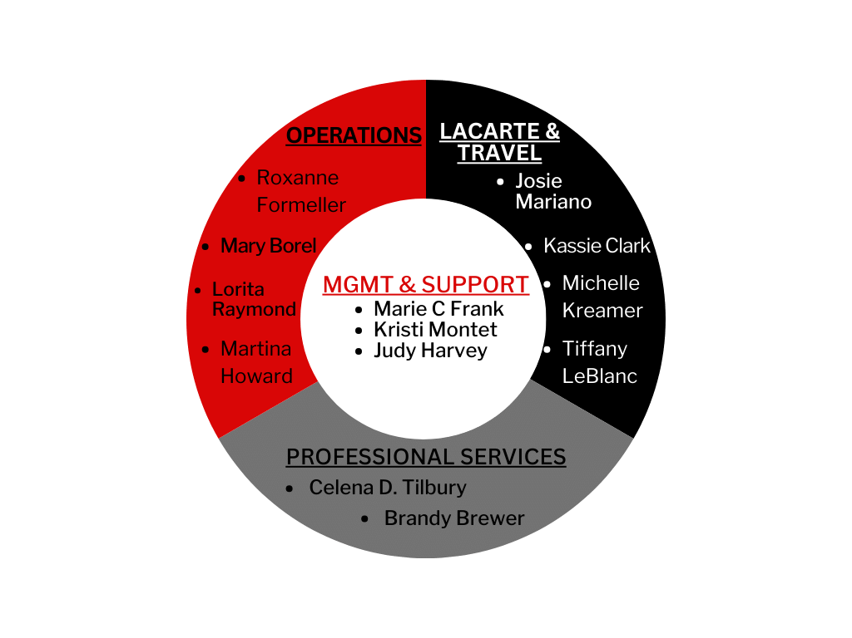

2024 Purchasing Staff
Notes:
SOME MIGHT CALL THIS THE PURCHASING DOUGHNUT. WE’D LIKE TO CALL IT A WELL-OILED WHEEL
PURCHASING IS SEGMENTED INTO 3 DIVISIONS
LACARTE AND TRAVEL – TRAINING IN THE FALL
PROFESSIONAL SERVICES – PRESENTING TODAY
OPERATIONS PROCUREMENT – US
CELENA TILBURY – ASSISTANT DIRECTOR FOR CONTRACTS AND STRATEGIC SOURCING
BRANDY BREWER – STRATEGIC SOURCING MANAGER
LORITA RAYMOND – PROCUREMENT COORDINATOR
MARTINA HOWARD – PROCUREMENT COORDINATOR
MARY BOREL – SR COORDINATOR – NOT PRESENTING TODAY
THOSE 3 SEGMENTS ARE SUPPORTED BY MARIE FRANK, DIRECTOR/ASSISTANT VP
KRISTI MONTET – TECHNOLOGY/SYSTEMS ANALYST
JUDY HARVEY – ADMINISTRATIVE SUPPORT
ME- ASSISTANT DIRECTOR FOR PURCHASING (OPERATIONS) 30 YEARS IN PURCHASING 16 YEARS AT UL

Slide 4

HOW TO PURCHASE
TRAINING STATISTICS
3% FORMAL TRAINING
17% TRIAL AND ERROR
78% COWORKER HELP
2% NEVER DID A REQ
(AFRAID TO MESS UP)
Exercise No. 1
Coworker A: My department head needs me to order hats for a project. How do I do that?
Coworker B:
___________?___________
Notes:
QUICK EXERCISE.
QUICK BIT OF RESEARCH I FOUND AND I WONDER HOW TRUE IT IS FOR YOU ALL:
SINCE THIS IS YOUR EXPERIENCE TOO, LET’S SEE HOW YOU DO.
EVERYONE IN HERE IS COWORKER B.
HOW WOULD YOU RESPOND?

Slide 5



Notes:
THE PURCHASING PROCESS IS SOMEWHAT OF A PUZZLE UNTIL WE GET ALL THE RIGHT QUESTIONS ANSWERED.
THERE’S A RIGHT WAY TO PUT THAT PUZZLE TOGETHER.
SO WHEN WE GET CALLS ASKING HOW TO PURCHASE SOMETHING, OUR STANDARD ANSWER USUALLY BEGINS WITH
IT DEPENDS
WHAT
WHO
WHERE
WHEN
HOW
WHY

Slide 6


HOW TO PURCHASE
Coworker A:
My department head needs me to order hats for a project. How do I do that?
What?
When?
Where?
How?
Who?
Why?
Notes:
YOU CAN SEE HOW THE CORRECT RESPONSE TO YOUR COWORKER WOULD REQUIRE MUCH MORE DETAIL. SO LET’S PUT ON OUR THINKING CAPS AND SEE WHAT QUESTIONS COME TO MIND:
WHAT KIND OF HAT?
WHAT IS THE BUSINESS PURPOSE?
WHEN DO YOU NEED THE ORDER DELIVERED?
WHEN IS THE EVENT TAKING PLACE?
HOW MANY DO YOU NEED?
HOW MUCH DO YOU ESTIMATE SPENDING?
WHERE SHOULD THE ORDER BE DELIVERD?
WHO WILL BE USING THE PRODUCT? FACULTY/STAFF? UNIFORMS… GENERAL PUBLIC? STUDENTS/ WHO DO YOU WANT BUY FROM? (There may be a conflict of interest.) We may not have an account. It may be a sole source. The company may be an authorized dealer.)
WHY SPEAKS TO THE BUSINESS PURPOSE. Office use? Job fair? Promotional item?
ANSWERS TO THOSE QUESTIONS SHOULD BE ON THE REQUISITION ITSELF TO THE GREATEST EXTENT POSSIBLE. A REQUISITION SHOULD BE ABLE TO FUNCTION AS A STAND ALONE DOCUMENT – PAINTING A CLEAR PICTURE, ANSWERING ALL OF THESE QUESTIONS.
WHEN WE GET IT RIGHT, THE WORKFLOW IS QUITE SEAMLESS.

Slide 7
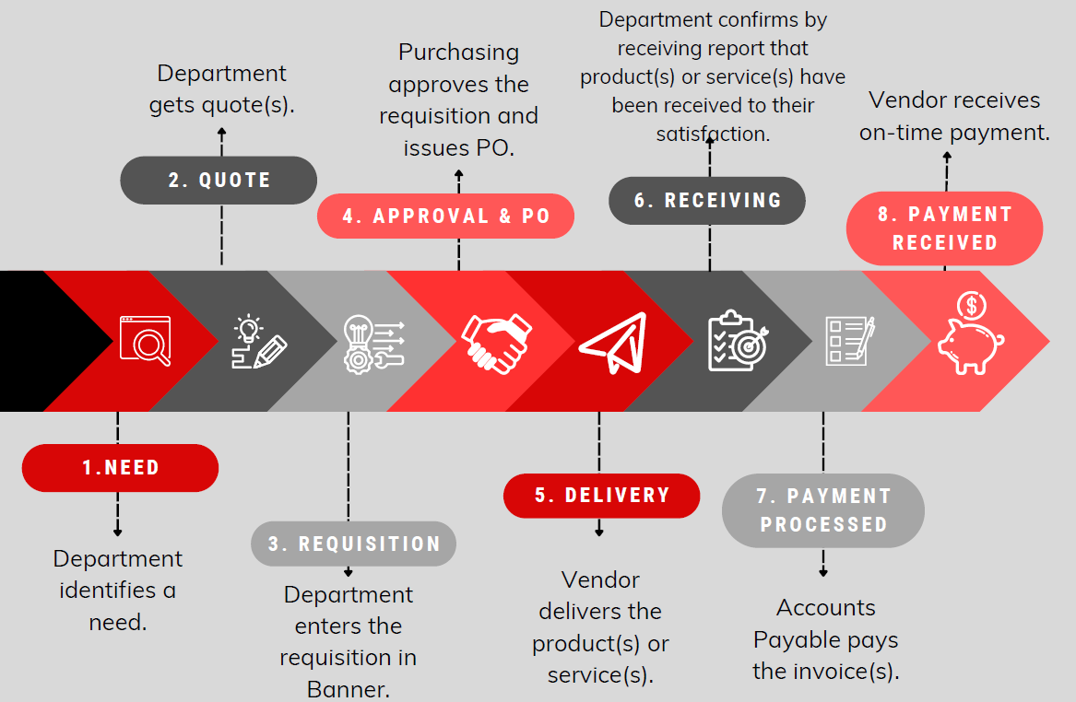

Operations Purchasing Workflow
***
***Some transactions require additional steps after requisition is approved before a PO can be issued.
Notes:
ANSWERS TO THOSE QUESTIONS SHOULD BE ON THE REQUISITION ITSELF.
LET’S TALK ABOUT THE IDEAL WORKFLOW FOR A REQUISITION.
EVERYBODY’S HAPPY.
WORTH REPEATING: A REQUISITION SHOULD BE ABLE TO FUNCTION AS A STAND ALONE DOCUMENT. THAT MEANS THAT THE ATTACHMENTS TO THE REQUISITION: THE QUOTE, THE INTERNAL FORMS, THE LETTERS FROM THE VENDOR… SHOULD ONLY SERVE AS SUPPORTING INFORMATION. THE TRANSACTION SHOULD BE FULLY EXPLAINED ON THE REQ IN BANNER.

Slide 8
Things you need to know before your purchase
The Purchasing Office is bound by State law and University policies that mandate how goods and services are procured.
Spending thresholds are based on the most recent Small Purchase Executive Order and other statutes. Additional restrictions have been put in place by the University.
Many state agencies are required to go through State Purchasing to purchase goods and services. As a university, we have been extended the privilege of doing our own purchasing.
There are at least 15 categories of exceptions that can be utilized by the campus community in lieu of obtaining multiple quotes/bids.
Additional requirements or documentation may be applicable, depending on the commodity and/or price of your purchase.
Your requisition may be disapproved. However, the goal is to work with you to get to “YES”.

Slide 9
Regulations Applicable to Purchasing Policy

Slide 10
Operations Purchasing Workflow
***
***Some transactions require additional steps after requisition is approved before a PO can be issued.
Notes:
ANSWERS TO THOSE QUESTIONS SHOULD BE ON THE REQUISITION ITSELF.

Slide 11
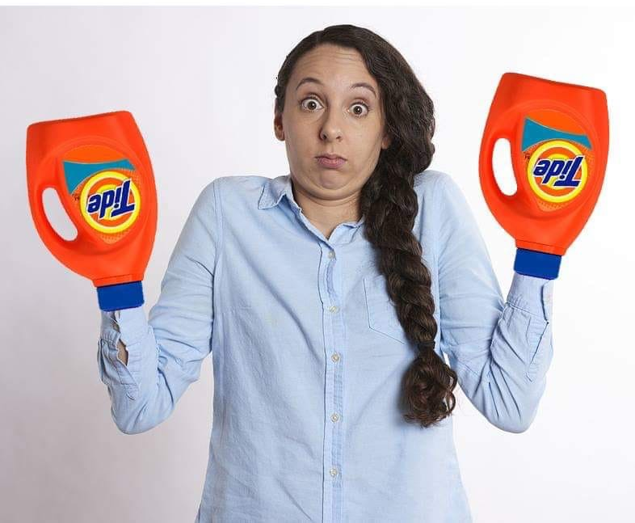

Errors and Omissions = Workflow Stoppage
I’m sorry. I would help but…
X
Notes:
We all saw the ideal work flow…
INADEQUATE REQUISITIONS GOT PASSED THROUGH ALL THE TIME. THE BUYERS WOULD GET THE REQ AND MAKE THE CORRECTIONS ON THEIR END. BUT……….. THE UNIVERSITY’S SPENDING HAS MORE THAN TRIPLED OVER THE PAST FEW YEARS. THE BUYERS SIMPLY DON’T HAVE THE TIME TO MAKE THE CORRECTIONS FOR THE REQUISITIONER.
SO I HAVE BEEN DISAPPROVING REQS IN AN EFFORT TO PUT THE BURDEN IN THE RIGHT PLACE, WITH THE DEPARTMENT.
WHEN A REQUISITION GETS DISAPPROVED, IT’S NOT AN INDICTMENT ON YOU, IT’S JUST THAT THE REQ IS NOT READY TO MOVE FORWARD.
PURCHASING IS WORKING DILIGENTLY TO PUT SOME NEW THINGS TOGETHER TO HELP YOUR REQUISITION TO MAKE THINGS EASIER:
MY BABIES: PURCHASING TIP OF THE MONTH; GENERAL PURCHASING AT A GLANCE
CELENA’S IDEA: MANAGING YOUR COPIES OF THE PURCHASE ORDER that Judy sends out with the PO
KRISTI’S UPDATES INCLUDING the A to Z library AT PURCHASING.LOUISIANA.EDU AND ALL THE BANNER TRAINING VIDEOS ON THE SITE
THERE ARE MORE UPDATES AND REFERENCE INFORMATION TO HAPPENING…

Slide 12
Non-Competitive Exceptions
*Indicates written justification is required to process the requisition. Check for instructions at purchasing.Louisiana.edu.
Total does not exceed $5,000
*Scientific and Lab Research Supplies & Equip up to $25,000
State Contract Purchases
(RFR required for some transactions >$25K)
Public Works Construction - up to $100,000
Software
(Additional restrictions for transactions over $150K)
*Professional Services
*Sole/Single Source Purchases
*Emergency Purchases
Used Equipment
Intergovernmental Purchases
Advertising
Utilities Includes cable services
Art Exhibits
and associated transport services
Subscriptions (Additional restrictions for transactions over $225K)
*Repairs or repair parts by authorized dealers
Orders for items on annual POs
Notes:
I have rarely met anyone at the University who has a job which they are afforded the luxury to be proactive. So when it is necessary to enter a requisition, NON-COMPETITIVE EXCEPTIONS SOMETIMES SAVE THE DAY. SO TAKE ADVANTAGE OF THE OPPORTUNITY TO USE THESE PROVISIONS.
NON-COMPETITIVE TRANSACTIONS ALLOW A REQUISITION TO MOVE SEAMLESSLY THROUGH THE APPROVAL PROCESS AND GETS FROM THE REQ TO THE PO MUCH MORE QUICKLY THAN OTHER REQUISITIONS. BUT MOST OF THOSE TRANSACTIONS REQUIRE ADDITIONAL DOCUMENTATION.
GET THE DOCUMENT FROM THE WEBSITE, NOT A COPY FROM A PRINT-OUT YOU HAVE FROM 1992.
ESPECIALLY RECENTLY, WE HAVE UPDATED FORMS WITH NEW INFORMATION/SPENDING THRESHOLDS.

Slide 13

Why is knowing ‘how to purchase’ important?
UNIVERSITY OF LOUISIANA AT LAFAYETTE
MISSION
The University of Louisiana at Lafayette offers an exceptional education informed by diverse worldviews grounded in tradition, heritage, and culture. We develop leaders and innovators who advance knowledge, cultivate aesthetic sensibility, and improve the human condition.
Notes:
THE UNIVERSITY HAS A MISSION STATEMENT
STATEMENT READS:
NOBLE INDEED. BUT IN ORDER TO MAKE THAT MISSION STATEMENT A REALIZATION FOR THE UNIVERSTIY, WE EACH HAVE TO DO OUR PART.
EVERYTHING WE TOUCH IN THE WORK FLOW, WE SHOULD MAKE IT OUR BUSINESS TO ADD VALUE. DOING THE RIGHT THING AND DOING THINGS RIGHT.

Slide 14


Questions? Questions?
Questions?

Slide 15
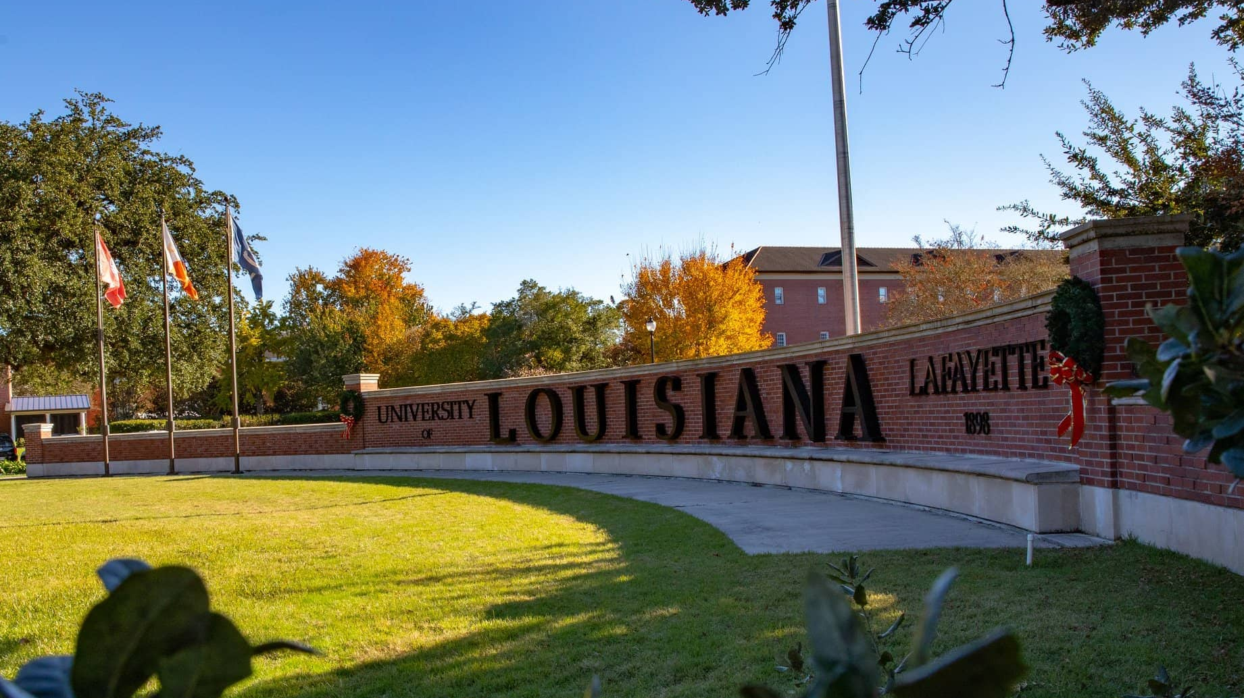
PURCHASE REQUISITIONS
By : Lorita Raymond

Slide 16

DO’S
Provide Vendor Contact Name and Email Address in Public Comments (Document Text)
Provide Item Codes (Commodity Codes)
Provide Detailed Item Description
Provide Correct Fund, Accounting, Program, Activity, Location and Project Code
Provide Ship To Location, Department, Attention to Contact Person, and Phone Number
Enter a Separate Line for Shipping Charges, AppleCare, Warranty, Etc.
Provide Location (Building and Room Number) for Copier Lease
Ask the Vendor to Provide State Contract Number on Quote (if Applicable)
Attach Completed Forms (Sole Source Justification, Non-Competitive Bid Form, Emergency Justification, Etc.)
Indicate discounts for line items

Slide 17
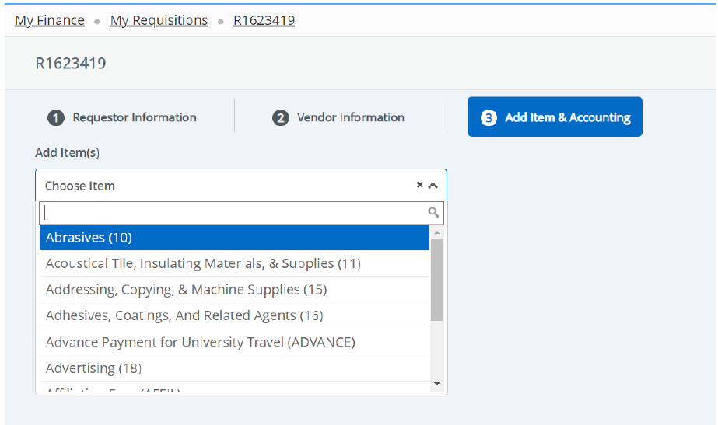
Provide Item Codes (Commodity Codes)

Slide 18
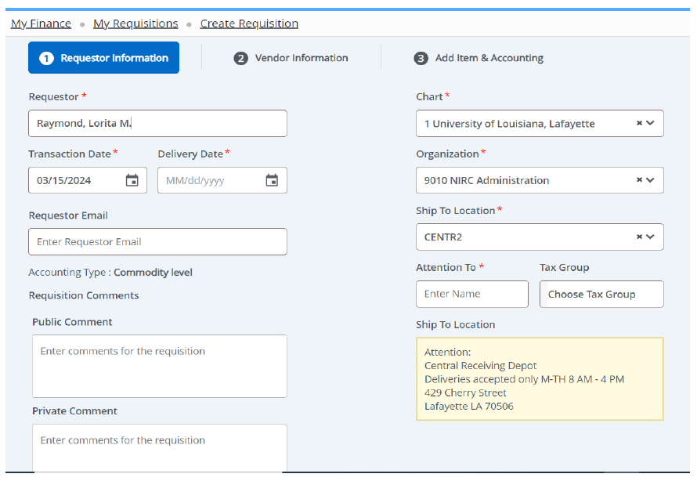

Provide Ship To Location, Department, Attention to Contact Person, and Phone Number

Slide 19
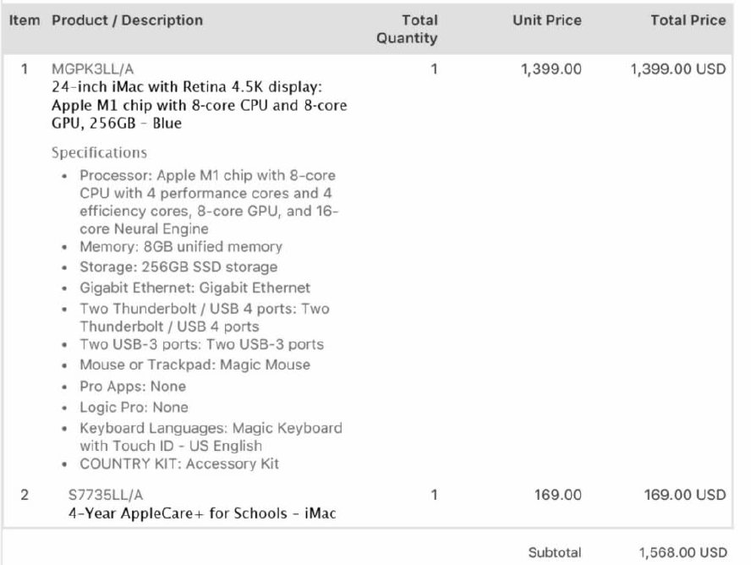
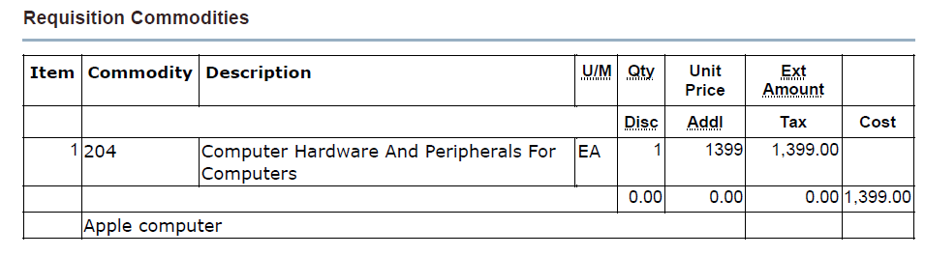
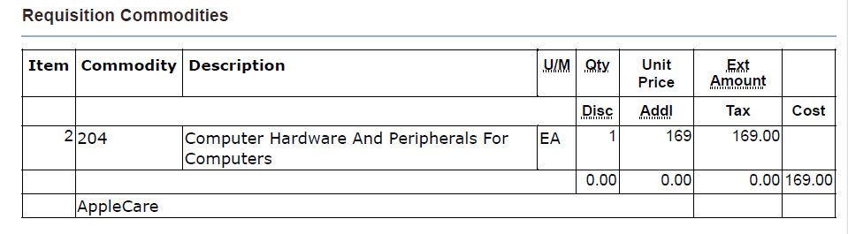
Provide as much detailed information as possible in the Item Description

Slide 20
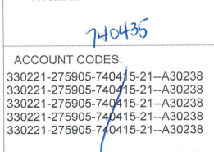
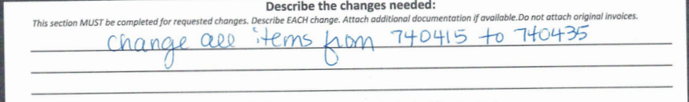
Provide Correct Fund, Accounting, Program, Activity, Location and Project Code

Slide 21
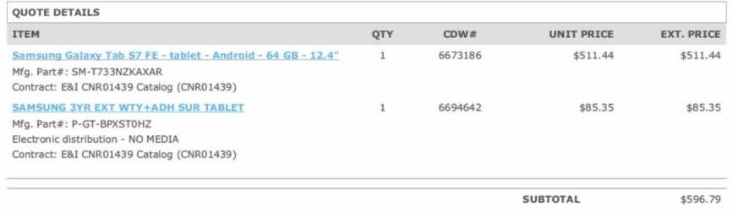
DO NOT Combine Line Items
Enter a Separate Line for Shipping Charges, AppleCare, Warranty, Etc.

Slide 22
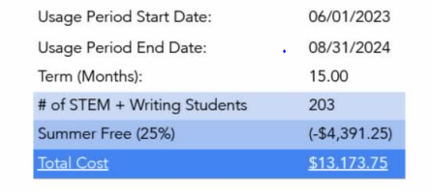
Requisition Total should match quote total
Do indicate discounts for line items

Slide 23

DON’TS
Do Not Pick Any Vendor with Similar Names
Do Not Leave Vendor Section Blank Unless Going Out Bid
Do Not Enter Line-Item w/$0.00 Value or Have a Negative Line Balance
Do Not Attach Expired/Soon to Expire Quotes
Do Not Accept Quotes Requiring Deposits or Down Payments
Do Not Sign Vendor Documents - Only the UL-Lafayette President, the VP of Administration & Finance, and the Purchasing Department have the authority to obligate the University to a written agreement
Do Not divide a purchase to avoid the procurement/bidding process.
Do not use “See attached” when writing a requisition

Slide 24
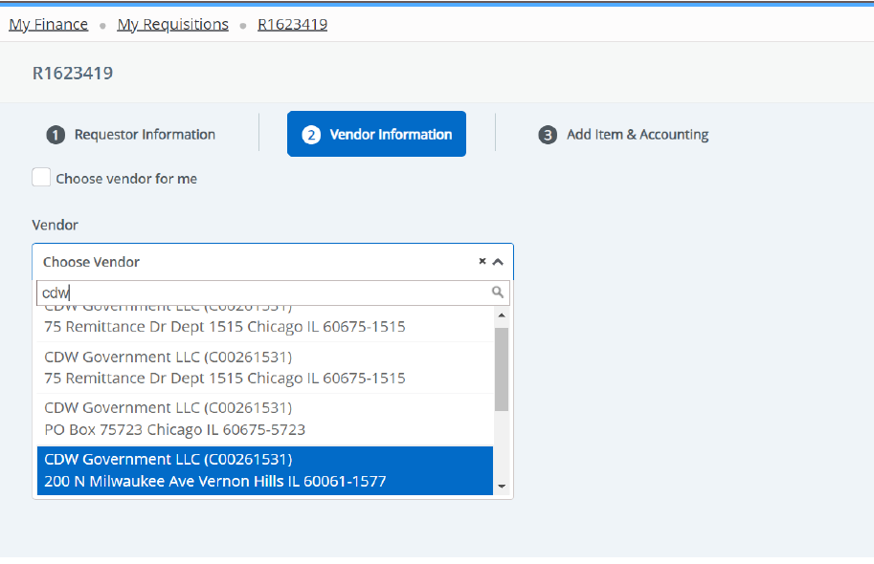
When choosing a vendor some have multiple addresses. Choose the address provided on the quote (if available)

Slide 25
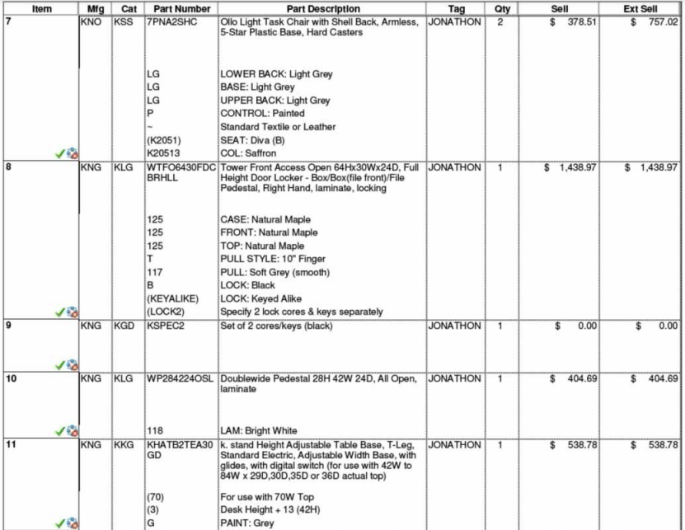
The requistion should be identical to the quote
If the line item on the quote has a $0.00 total - Add information in the public comments

Slide 26
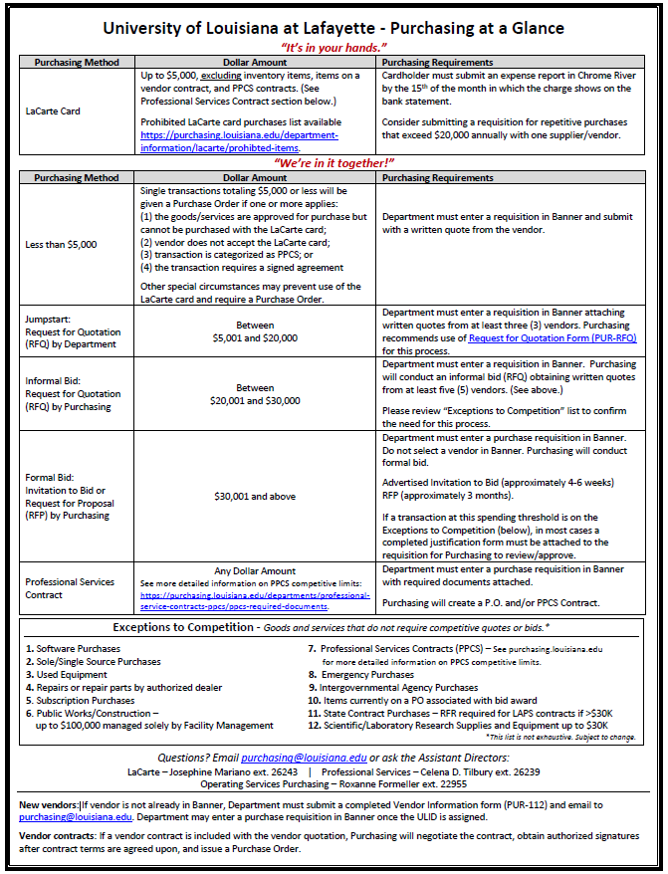
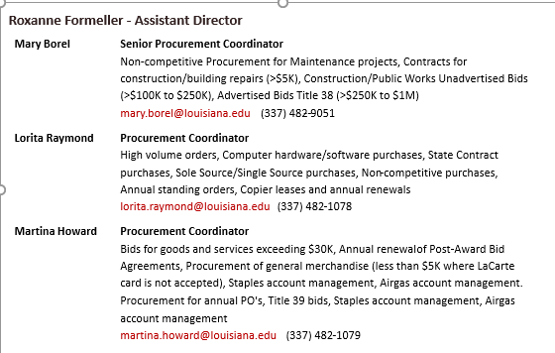
University of Louisiana at Lafayette RFQ/Bid Quick-Reference
Transaction Total | Responsible Party | Must Allow Vendor (minimum) | University Requirements
$.01 to $5,000* | Requisitioner or Project Mgr. | N/A | Requires no competition – requires only one (1) quote
$5,001 to $20,000 | Requisitioner or Project Mgr. | 24 Hours | Requires three (3) vendors be solicited to quote
$20,001 to $25,000 | Requisitioner or Purchasing | 72 Hours | Requires five (5) vendors be solicited to quote
Over $25,000 | Purchasing | 21 Days | Requires formal advertised sealed bid inviting a minimum of five (5) vendors
X
X
X
X

Slide 27


A-Z Purchasing Library - purchasing.louisiana.edu
Purchasing Staff - https://purchasing.louisiana.edu/about-us/staff
State Contract Search - https://wwwcfprd.doa.louisiana.gov/osp/lapac/ecat/dsp_ecatsearchlagov.cfm
Vehicle Order Instructions - https://www.doa.la.gov/media/vdhgkfbv/lagovvehicleorderinstructions-1-rev-12-3-2021.pdf
Purchasing Forms: https://purchasing.louisiana.edu/forms

Slide 28
ANY QUESTIONS?

Slide 29
What is a bid?
QUOTE
Informal
Total is less than $20K
Can be requested by anyone
Must be submitted with requisition
Provided on-the-spot by vendor
BID
Formal
Exceeds $25K
Done by Purchasing only
Specifications must be submitted with the requisition
Takes 4-6 weeks (must be advertised)

Slide 30

What to include in bid specifications
WHAT?
WHAT IS THE SCOPE OF WORK?
WHAT SUPPORTING DOCUMENTS (DRAWINGS) YOU WANT TO SHARE?
WHAT DO WE WANT TO ORDER IS IT EQUIPMENT OR SERVICE?
WHAT QUALIFICATIONS WILL THE BIDDER NEED?
WHAT ARE THE PARTS? (ITEM#, SUBSTITUTION ALLOWED?, ETC)
WHAT IS ACCEPTABLE/WHAT IS NOT?
WHO/WHEN?
WHO IS THE PROJECT MANAGER?
WHO DO YOU WANT TO SEND THE INVITE TO? (VENDOR LIST)
WHAT ELSE?
DO YOU REQUIRE A PRE-BID MEETING?
DO YOU REQUIRE A MADATORY SITE VISIT?
SPECIAL INSTRUCTIONS (NEED BY DATE)
BE VERY SPECIFIC
WHERE/HOW?
HOW OFTEN DO YOU NEED THE WORK DONE?
WHERE DOES IT NEED TO BE DELIVERED? (LOCATION)

Slide 31
Questions?
Questions?
Questions?

