Slide 1

How to Buy for the University
Requisition Entry

Slide 2

Agenda
Introductions
  General Purchasing Workflow
  Vendor Registration
  Spend Thresholds/Competitive Limits
  Professional Services (PPCS) Workflow
  Exceptions to Competition
  Avoiding Delays
  Purchasing Resources
  Q&A
Notes:
HERE IS TODAY’S AGENDA.

Slide 3
Purchasing Workflow (General)
Department
Identifies need -- Obtains quote(s) -- Enters requisition
Purchasing
Approves requisition -- Negotiates final agreement -- Issues PO
Vendor
Accepts order -- Delivers -- Sends invoice
Department
Confirms receipt
Accounts Payable
Pays invoice
Vendor
Receives payment
Notes:
In general, this is how the workflow should go…
Because we purchase so many different things here at the University – paperclips to construction of tall buildings, there is no one-size-fits-all procedure that we can give you. If there were, you wouldn’t need Purchasing at all.
What do we do to avoid delays?

Slide 4
Vendor Registration
1
2
3
Search Banner
Check Vendor Information Tab on Requisition to determine if the vendor already has a Banner ID.
Request a Vendor
If the vendor is not found, complete the Vendor Information Form (PUR-112) and email to Purchasing.
Enter Requisition
Once the vendor ID is assigned and sent to you from Purchasing, proceed with your Banner requisition.
How PaymentWorks Fits In
Purchasing invites the vendor to register through PaymentWorks. The vendor is responsible for completing and maintaining their own information. Departments should follow up with the vendor to ensure registration is completed.

Slide 5
Things to Know Before You Purchase
Purchasing Office must follow State law and University policies.
The Governor’s Small Purchase Executive Order and other statutes establish spending thresholds.
Additional documentation required to justify some purchases.
The goal in the approval process is to work with you to get to “YES”.
Purchasing is a privilege extended to the University.
Notes:
Foundation reimbursements
Some thresholds are stricter than exec order.
More than just a quote.
Misuse of privilege can get that privilege rescinded to a great extent.
Use the provided resources. Give yourself time. Submit complete information.

Slide 6
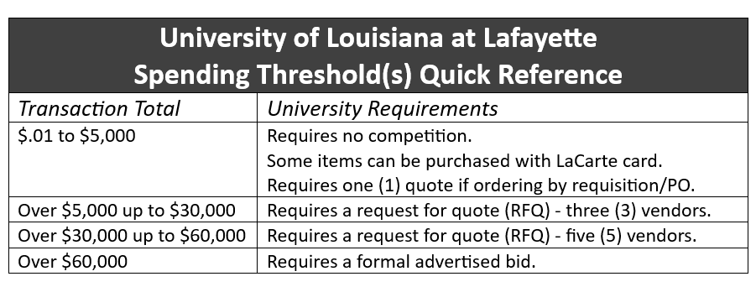

Spending Thresholds
Notes:
PURCHASING AT A GLANCE
PURCHASING TIP OF THE MONTH

Slide 7
Professional Services (PPCS) Workflow
Negotiate Payment Terms and Services
  Obtains a firm quote, proposal and/or agreement.
  Define the payment terms and Scope of Services.
  Obtain the Contractor’s completed, signed PUR-CIR form.
    Best Practice: Include Travel Expenses in fee. If not included, must follow PPM-49. Reimbursement for all expenses must have receipts or documentation attached to the invoices or reimbursement will not be made.
    No advanced payment or deposit allowed.
  2. Verify Vendor Information
  Confirm the vendor is in Banner and information is correct.
  If no found, submit the Vendor Information Form to Purchasing@louisiana.edu.
  3. Submit Banner Requisition
  Attach required PPCS documents, including PUR-CIR form and Scope of Services (PUR-SS) in Word, to the requisition.
  4. Determine Contract Threshold
  $5,000 or less
  $5,001 - $49,999
  $50,000
  Thresholds are based on the same services with a 12-month period. Purchasing determines the applicable requirements.

Slide 8
Professional Services (PPCS) Workflow
  5. Purchasing Review & Approval
  Purchasing reviews documents and obtains additional information as needed.
  Purchasing coordinates contract signatures through DocuSign, when applicable.
  Purchasing issues Purchase Order (PO) and distributes the executed contract.
6. Contractor performs Work/Services
Work may begin only after the required contract approvals and PO are complete.
  7. Monitor Services & Process Payments
Project Manager verifies deliverables and Contractor performance.
Approved invoice(s) and submit them with the PO Receiving Report to Accounts Payable for payment.
Notify Purchasing of issues or needed amendment before the contract expires (within 30 days of expiration).
7. Complete Contractor Evaluation Contract.
Project Manager completes and signs the Contractor Evaluation Form (PUR-PE) after services are complete.
Email the evaluation to purchasing@louisiana.edu to close out the contract file.

Slide 9
Professional Services (PPCS) Important Reminders
  Payment & Travel
  No advance payments or deposits
  Include travel in the contractor's fee whenever possible.
  Otherwise, follow PPM-49. Required receipts and supporting documentation must accompany reimbursement requests.
  Required Documentation
PUR-CIR must be completed and signed by the Contractor.
PUR-SS must clearly describe services, deliverables, and payment terms.
Attach the Contractor's quote, proposal, or agreement as applicable.
Plan Ahead
Submit requisitions well before the anticipated start date.
Never sign a Contractor's agreement on behalf of the University.
Do not begin work before the required approvals and PO are in place.
Submit amendments before the existing contract expires.

Slide 10
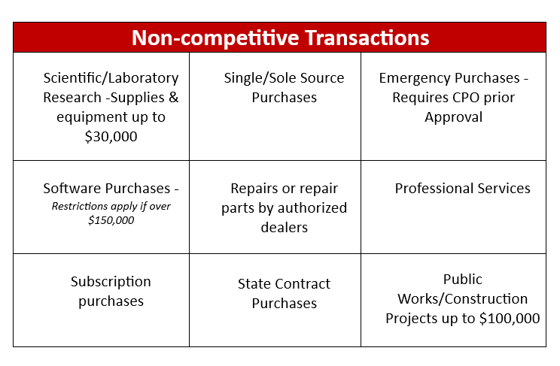
Exceptions to Competition
Forms providing justification are required to process these transactions. Check for instructions at purchasing.louisiana.edu.
Notes:
I have rarely met anyone at the University who has a job which they are afforded the luxury to be proactive. So when it is necessary to enter a requisition, NON-COMPETITIVE EXCEPTIONS SOMETIMES SAVE THE DAY. SO TAKE ADVANTAGE OF THE OPPORTUNITY TO USE THESE PROVISIONS.
NON-COMPETITIVE TRANSACTIONS ALLOW A REQUISITION TO MOVE SEAMLESSLY THROUGH THE APPROVAL PROCESS AND GETS FROM THE REQ TO THE PO MUCH MORE QUICKLY THAN OTHER REQUISITIONS. BUT MOST OF THOSE TRANSACTIONS REQUIRE ADDITIONAL DOCUMENTATION.

Slide 11
Exceptions to Competition - continued
Totals less than $5,000.00
Property Leases/Rental
Animal Purchases
Publications
Termite Service Renewals
Used Equipment
  - requires special approval
Intergovernmental Purchases
Advertising
Utilities
Art Exhibits & transport services
Subscription purchases
Orders for items on annual POs already competitively bid
Musical Instruments up to $10,000.00
Notes:
Except for the 1st one listed, these are less frequently used than the ones on the previous page.

Slide 12


Avoiding Delays
Quote missing or expired
Requisition doesn’t match quote
Formal bid required
$0 line item
Nothing attached
NSF – Insufficient funds
Taxes on quote
Contract signed by unauthorized person
Freight not on requisition
Transaction requires additional quotes
Required forms missing
Requisition not itemized
Multiple lines – no commodity selected
Incorrect Accounting information
“I’m sorry but…”
Use your resources. | Plan ahead. | Give your transaction the time it requires.

Slide 13
Resources
Office of Purchasing Website
https://purchasing.louisiana.edu/
Banner Training
How to enter a requisition
Editing a requisition
Purchasing Forms
Links to all available forms
Purchasing at a Glance
Quick reference guide
Competitive limits outlined
State Contracts Louisiana’s
Electronic Catalog (LA eCat)
Search all available State Contracts
by name or description
Small Purchase Executive Order
Current Executive Order with spend limits
Adding a New Vendor to Banner
Links to necessary forms
Notes:
Use your resources.
Purchasing website
Forms
Training video and printable slides
Links to other resources can be found
Call us.
WHEN IN DOUBT, REACH OUT.

Slide 14
Purchasing Staff
General Purchasing Questions Purchasing purchasing@louisiana.edu 482-5396
General LaCarte Card Questions LaCarte lacarte@louisiana.edu 482-5396
Professional Services (PPCS) Celena Tilbury celena.tilbury@louisiana.edu 482-6239
General Purchasing, Bids,
Renewals, Construction Roxanne Formeller roxanne.formeller@louisiana.edu 482-2955

Slide 15
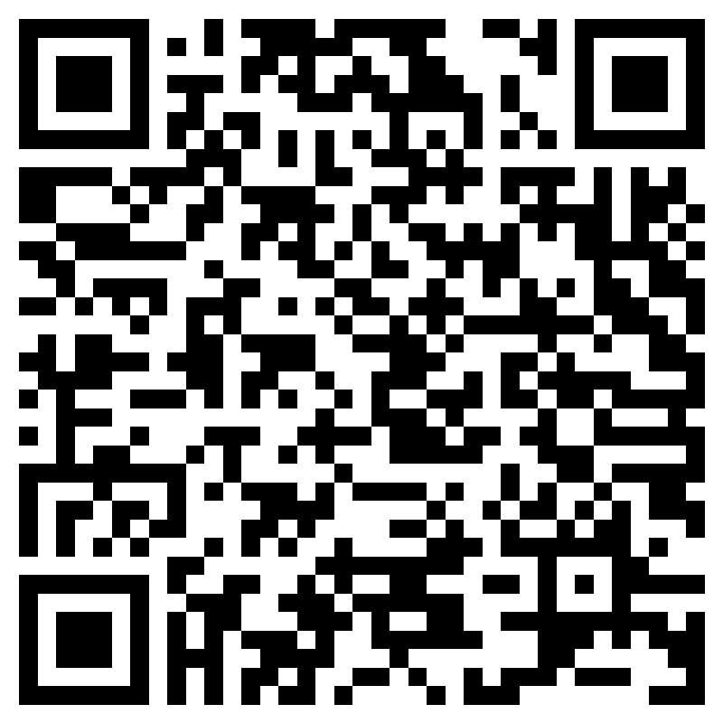
Sign in Sheet

Slide 16
Questions?

